Slide 1


19th April 2026
Post Mortem Client Check-in Investment Strategy
Protecting and growing $1,000,000 through one of the most volatile quarters in recent markets
CHL-0200 SP26
THE INVESTMENT CHALLENGE
Prof. Daniela Neiderer
TEAM 5 LON 2 - BWC
Kartavya Jharwal
Aliah Muhammad Asharaf
Pedro Junqueira
Azriel Fernandes
Devarya Shah
Nandini Prakash Rangani
Abdul Rafay Malik
Sayhan Mushrif

Slide 2
About the Client
Who are they & what do they want?
Client: high risk tolerance, growth-focused, $1,000,000 to deploy over Feb–Apr 2026
Objective: outperform SPY while keeping risk within agreed limits
Investment Policy Statement: no security >9% of capital, no sector >25%, target beta around 1.0

Slide 3
Setting the Macro scene
  Feb 2026: Nasdaq already distributing, US–Iran tensions escalating, Fed cuts repeatedly deferred
  Q4 international fiscal year end: earnings calls, audit season, and annual reports driving institutional repositioning
  By late March: S&P 500 down ~8–9% YTD with volatility spikes and headline-driven gaps

Slide 4
The barbell of balance
Conservative
Agressive
DEFENSIVE FLOOR
GROWTH ENGINE
Everything Built Inside IPS Guardrails
Utilities, staples, and gold to stabilise drawdowns
  XLU
  XLP
  GLD
High-conviction AI and quality growth
  NVDA
  AMZN
  GOOGL
  PLTR
  ORCL
  No security above 9%
  No sector above 25% at any point

Slide 5
The story of the money
We finished at $956,280: an absolute loss of 4.37% versus SPY at −2.29% for the period
OUTPERFORMED
UNDERPERFORMED
We outperformed during the crash: max drawdown ~−6.3% vs SPY around −8.5% at the trough
We underperformed in the rebound: a slow, cautious re-entry into equities after the ceasefire left 2–3% on the table
Final return
$956,279
Our return
−4.37%
SPY return
−2.29%
Max drawdown
−6.27%
Underperformance
208 bps

Slide 6

Adapting to Market Conditions
Foundation
01
  Initial allocation to SPY and defensive equities
  Diversified exposure across sectors
  Portfolio beta ~1.0
Growth (Early–Mid March)
02
  Increased exposure to growth stocks (NVDA, ORCL)
  Rotation into outperforming sectors
  Portfolio beta increased to ~1.1
Crisis (Late March)
03
  Shift to hedging assets (GLD, SH, PSQ, metals)
  Reduced equity exposure
  Portfolio beta reduced to ~0
Recovery (Early-Mid April)
04
  Re-entry into equities (SPY, XLF, XLI, JPM)
  Gradual increase in exposure
  Portfolio beta ~0.6

Slide 7
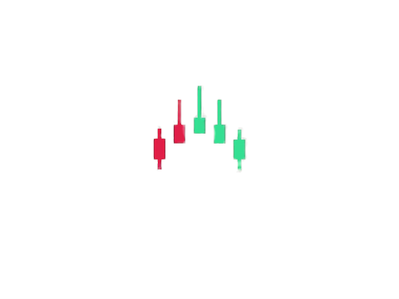
A Regime-Based Investment Strategy
GROWTH
(RISK-ON)
CRISIS (RISK-OFF)
RECOVERY(RE-RISK)
  Core SPY and AI
  Target beta ~1.0+(Quality Growth)
  Emergency Override on 30 March into SH, PSQ, AA, CENX and gold
  Net beta ~0
  Rotation back into SPY, ESGU, XLF, XLI, CAT, JPM after the April 8 ceasefire with
  Beta ~0.6

Slide 8
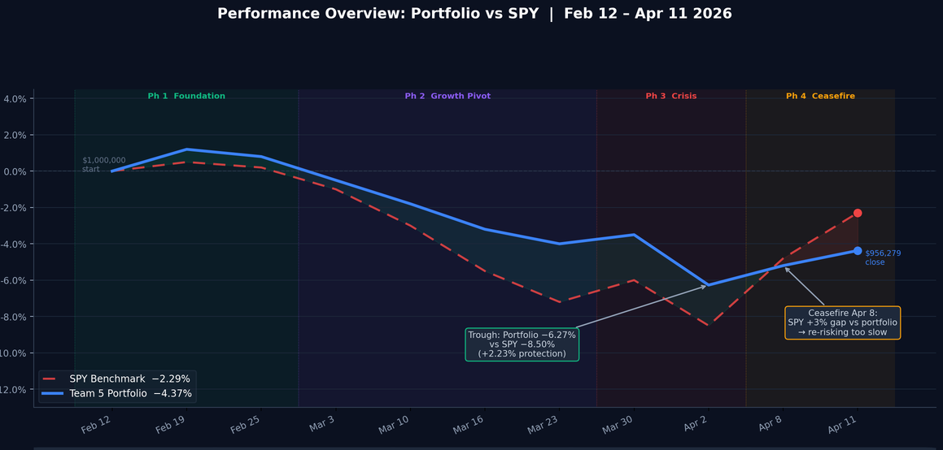
Key Performance Overview
Profit Factor
Avg Win ($)
Sharpe Ratio
Omega Ratio
Jensen's Alpha
0.166
$3176.75
-2.111
0.166
-0.000443
Treynor Ratio
Expectancy
Beta
Win Rate
Avg Loss ($)
Sortino Ratio
Calmar Ratio
M² (Modigliani)
Information Ratio
-0.138
-$4,558.91
0.628
28.57%
-$7653.18
-4.156
-0.645
-0.274
-2

Slide 9




Quant
Our Quantitative
Python Deep Learning

Slide 10

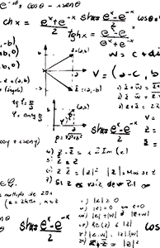

Confidence, not autopilot
The model as a confidence engine, a closed-universe stochastic simulation over the remaining trading days.
Simulations used our live positions, observed volatility from the market, and textbook assumptions to generate distributions of potential outcomes,
When conviction was thin, the model helped size positions and interpret risk.

Slide 11

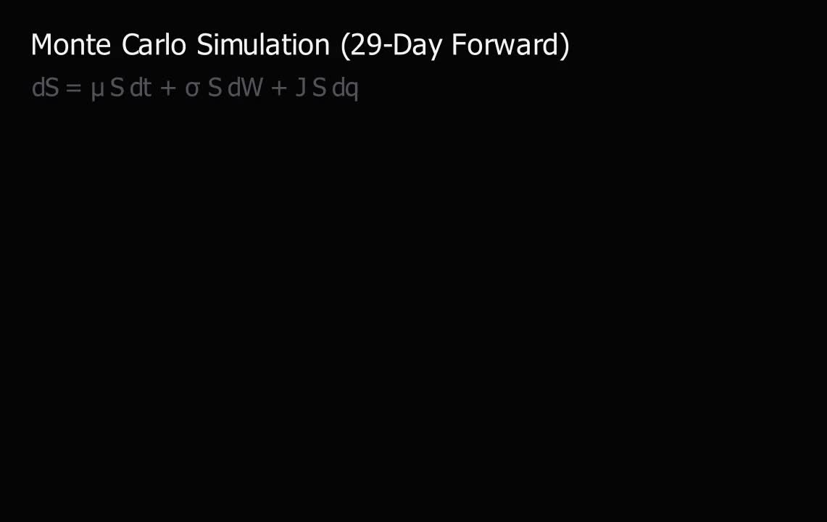

Slide 12

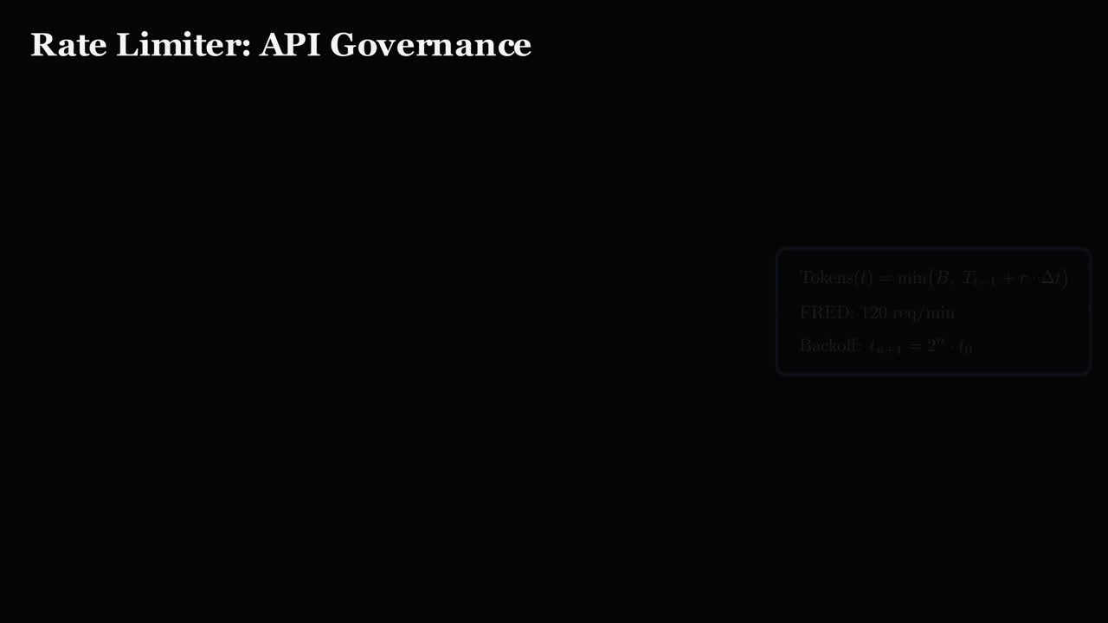



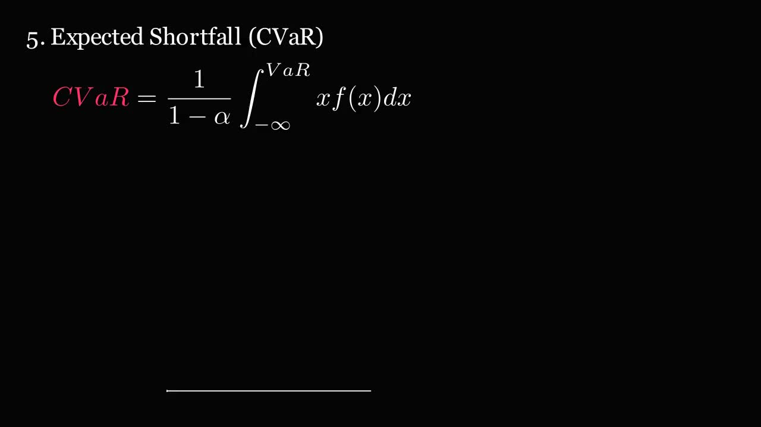










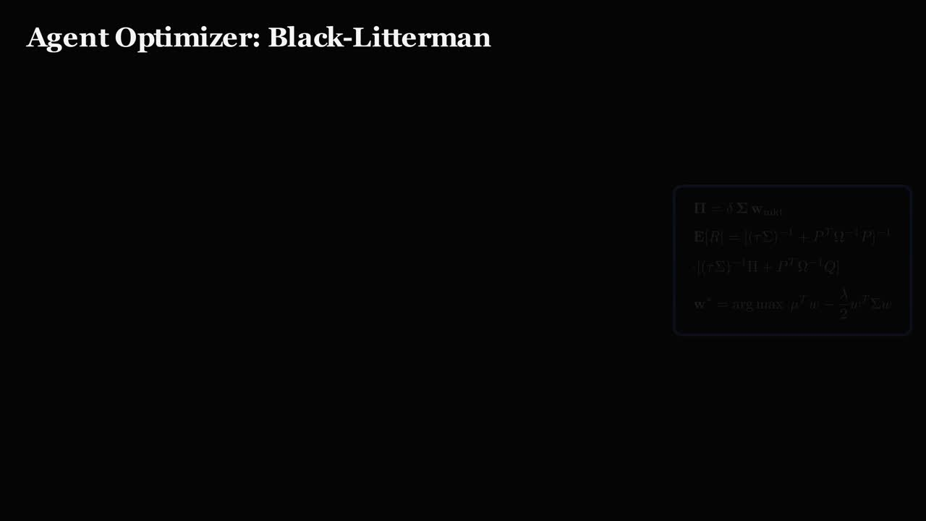
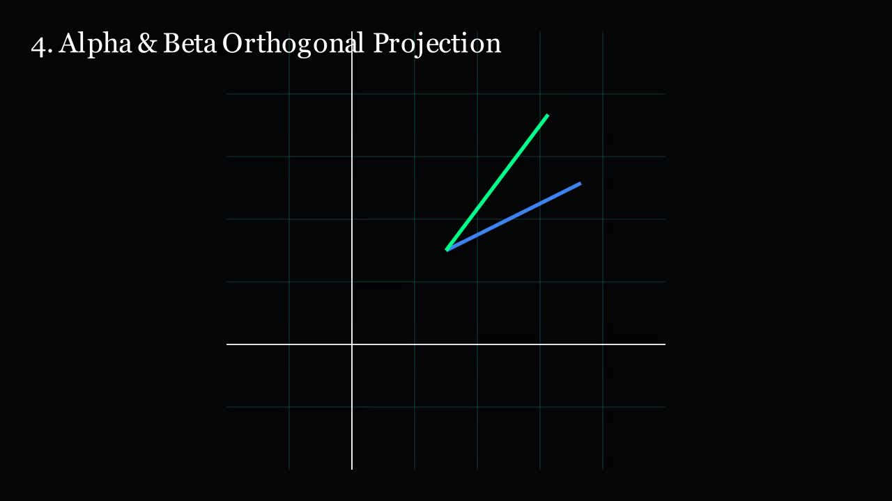



Slide 13

Crisis
Failure Management

Slide 14
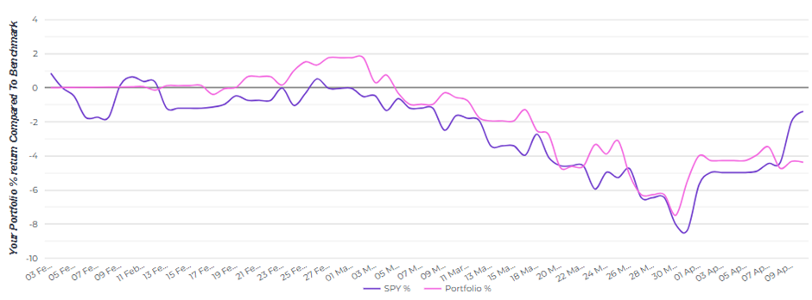
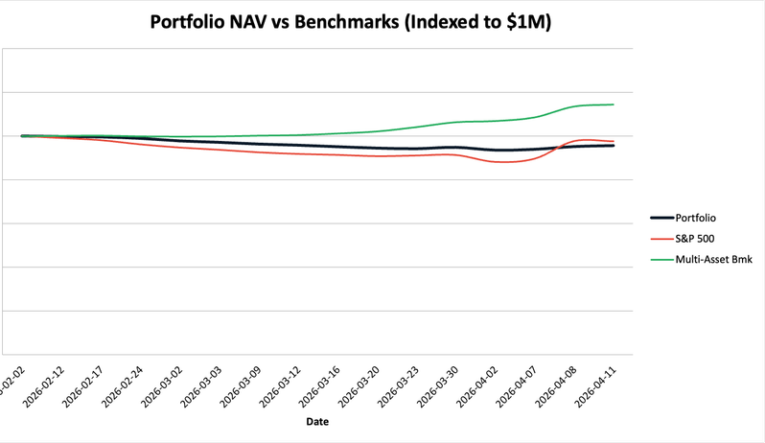
The April 2 fake-out and April 8 lag
  March 30: Emergency Override into inverse ETFs and crisis metals was directionally correct in a confirmed correction
  April 2: binary policy shock and tariff surprise produced a +7.5% style rally that burned the hedges in a single session
That fake-out created psychological scar tissue, on April 8 we demanded confirmation before re-risking, which cost ~300 bps in the snap-back

Slide 15

Simulation Mechanics vs. Fiduciary Reality
  StockTrak distortions and phantom accounts inflated starting capital for much of the cohort, making raw rankings misleading
  Many teams effectively ignored the Investment Policy Statement.
  In real markets, losing money while following the rules is an insurance event; losing money while breaking them is a lawsuit, we chose the former standard
Notes:
We recognized early that optimizing for a 3-month platform competition required abandoning some risk limits. We actively chose to treat this as a longer institutional horizon, accepting short-term underperformance in exchange for long term success.

Slide 16
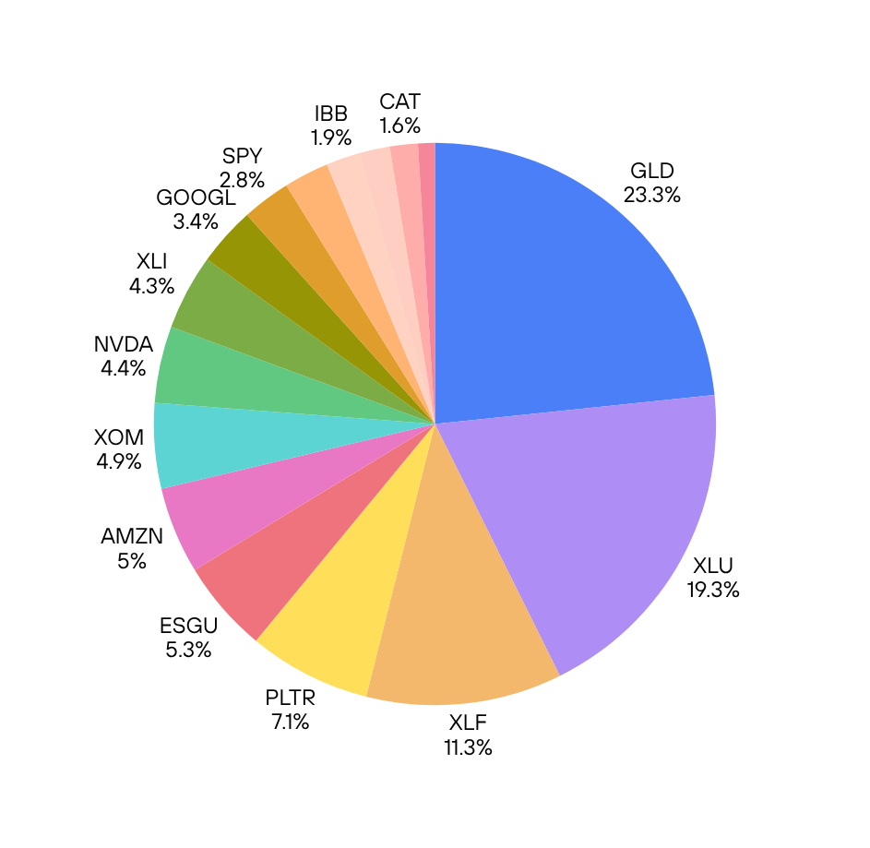
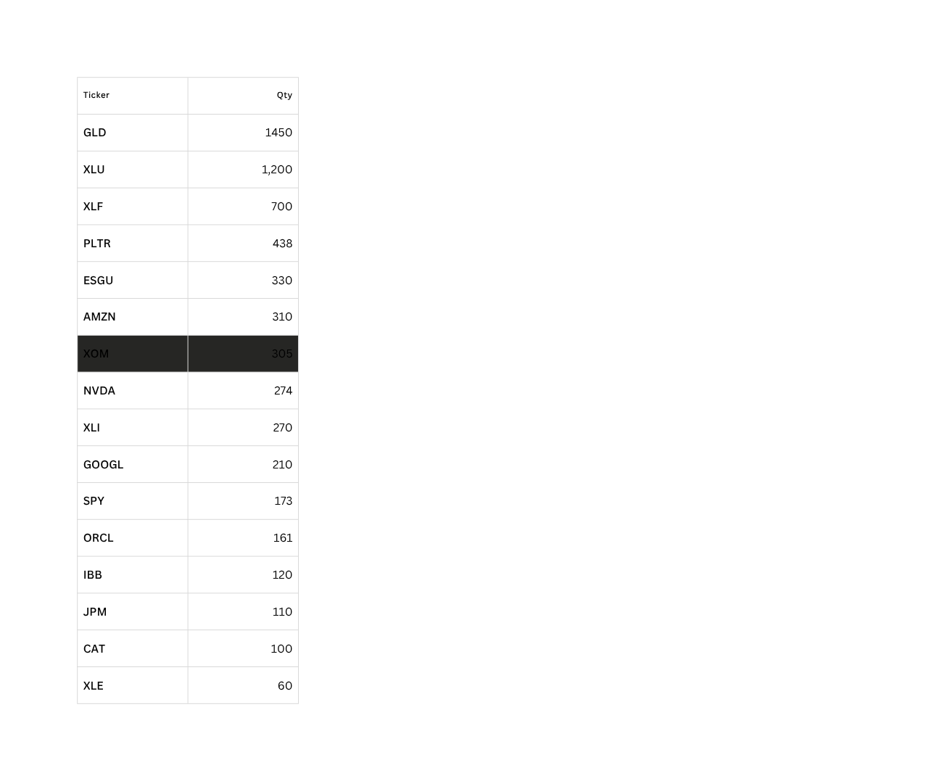
Current book and forward path
  Final holdings balance core beta (SPY, ESGU) with quality growth (AMZN, NVDA, GOOGL, PLTR) and regime‑resilient assets (GLD, XLF, XLI)
  The freeze date stops the simulation but not the thesis – this is a diversified, conviction‑based book designed to compound beyond a three‑month window

Slide 17
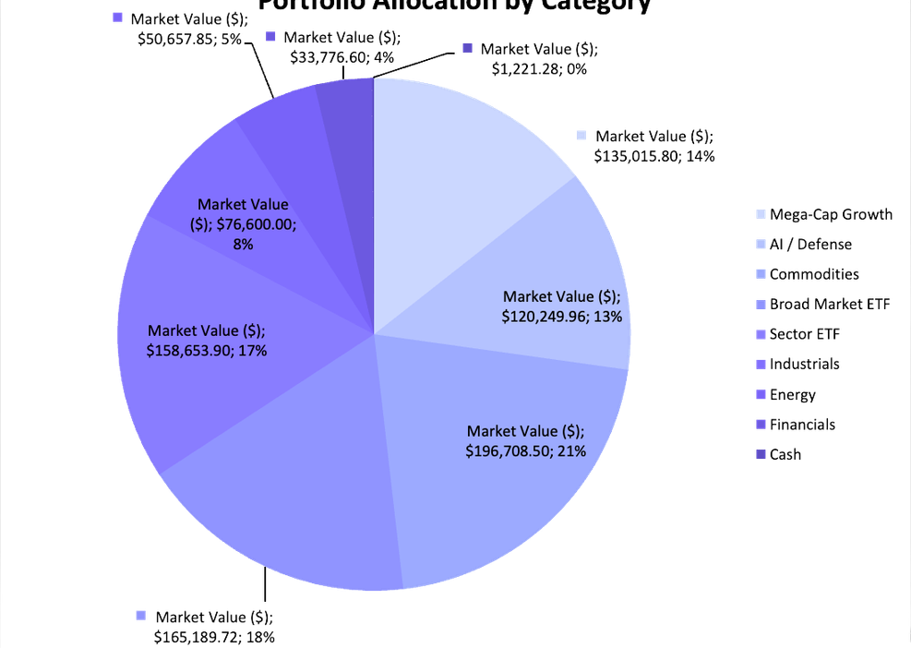
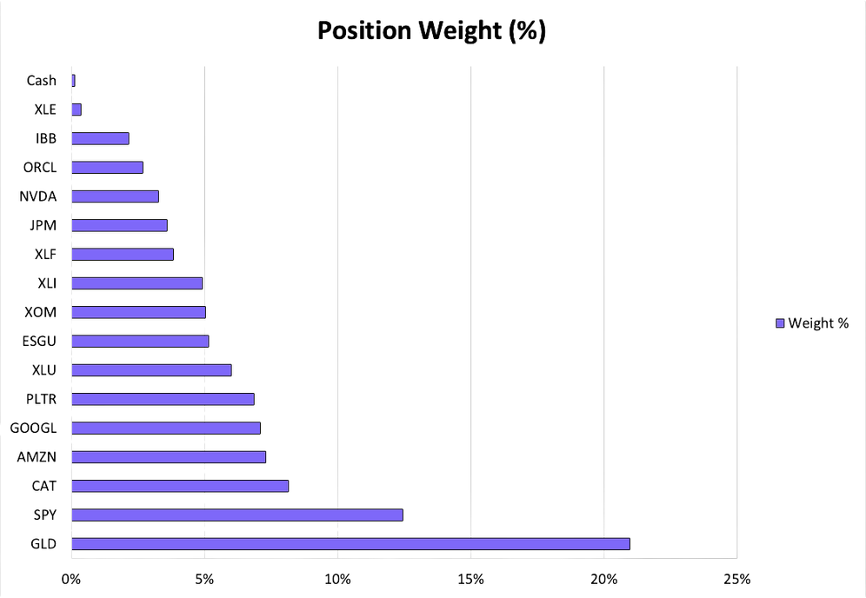
Portfolio Construction

Slide 18
Recommendation
Pre-Set Regime Transition Rules:
Keep the barbell structure:
  Speed of re-evaluation is itself a competitive edge
  Binary events need immediate pre-committed rules
  Maintain core equities + crisis hedge approach.
  Low-beta foundation protected −2.23% more drawdown than SPY.
Replace Inverse ETFs with Put Options:
  Diversify with options and other instruments
  Allocate 1–2% of NAV to OTM SPY puts instead
  Convex payoff: loses only premium in calm markets, pays off in crashes

Slide 19
Conclusion
Be profitable & have fun
  The original charter was simple: be profitable and have fun – we fully delivered on the second and built the foundations for the first
  Across one of the most volatile recent quarters, we protected capital, learned to operate inside an IPS, and thought like fiduciaries, not students
  In a three‑month simulation, the noise trader can win the leaderboard; in a three‑year fund, disciplined process and risk management win for the client

Slide 20



Thank you for listening
We are open for questions!
Fancy a ‘pint’ and ‘brownies’?

